Slide 1
GOSPEL OF JOHN
John 2:1–11
The Beginning of Miracles
The party · The predicament · The provision · The purpose
Core content based on John MacArthur’s Exposition of John · GTY 43-8

Slide 2
FROM LAST WEEK
Verbal testimony is now behind us
Chapter 1
John the apostle. John the Baptist. The first disciples. Words that confess who He is.
Chapter 2
Works that prove who He is. John will now alternate words and works through the Gospel.
Purpose unchanged
These are written that you may believe that Jesus is the Christ, the Son of God, and that by believing you may have life in his name. (John 20:31)
John 20:31 · biblegateway.com

Slide 3
WHERE WE ARE
Public ministry begins
John 1
John 2–12
John 13–17
John 18–21
Verbal testimony
Public ministry
Private ministry
The hour
Who He is, spoken
Signs and words to Israel
Upper Room — His own
Death, resurrection, appearances
Cana is the first public act. Nazareth will later try to throw Him off the cliff.

Slide 4
JOHN’S EIGHT SIGNS
Samples of what only God can do
John 2
John 4
John 5
John 6
Water into wine
The official’s son
The paralyzed man
Bread for thousands
John 6
John 9
John 11
John 21
Walks on the sea
Sight to the blind
Lazarus raised
Breakfast created
John 20:30 — many other signs are not written in this book. The resurrection stands over them all.

Slide 5
THE TEXT
John 2:1–5
On the third day there was a wedding at Cana in Galilee, and the mother of Jesus was there. Jesus also was invited to the wedding with his disciples. When the wine ran out, the mother of Jesus said to him, “They have no wine.” And Jesus said to her, “Woman, what does this have to do with me? My hour has not yet come.” His mother said to the servants, “Do whatever he tells you.”
John 2:1–5 ESV · biblegateway.com

Slide 6
THE TEXT
John 2:6–11
Now there were six stone water jars there for the Jewish rites of purification, each holding twenty or thirty gallons. Jesus said to the servants, “Fill the jars with water.” And they filled them up to the brim. And he said to them, “Now draw some out and take it to the master of the feast.” So they took it. When the master of the feast tasted the water now become wine, and did not know where it came from (though the servants who had drawn the water knew), the master of the feast called the bridegroom and said to him, “Everyone serves the good wine first, and when people have drunk freely, then the poor wine. But you have kept the good wine until now.”
This, the first of his signs, Jesus did at Cana in Galilee, and manifested his glory. And his disciples believed in him.
John 2:6–11 ESV · biblegateway.com

Slide 7
THE PARTY
A wedding in Cana
The third day
Why a wedding
After the days of chapter 1. A small Galilean village about nine miles from Nazareth.
The most significant social event of ancient village life. Days of feast after a year of the bridegroom preparing a home.
Jesus is invited
He honors marriage
He is no ascetic. He comes. Mary is already there — family and neighbors in a town that small.
Marriage is God’s covenant, the highest human relationship, common grace — not a Roman sacrament that saves.
Societies that honor marriage are blessed temporally. Societies that diminish it come apart.

Slide 8
THE PREDICAMENT
They have no wine
Shame on the host
Wine as staple
The bridegroom’s duty was to provide. Running out was public failure in a week-long feast.
Daily drink, usually mixed. Water was often unsafe. This is not a license text; it is a provision text.
Mary comes to Him
Not Mariolatry
She has watched Him for thirty years. She trusts His wisdom. She does not command a miracle.
This is her only recorded request of Him. He does not put her between sinners and Himself.
“They have no wine.” She brings the need. She does not dictate the means.

Slide 9
THE PREDICAMENT
Woman — My hour has not yet come
Woman
My hour
Not cruelty. Distance. The thirty-year mother-and-son arrangement is over. From here He does the Father’s business, not hers. Compare Luke 2:49; Matthew 12:46–50; Luke 11:27–28.
The divine timetable that runs to the cross and the glory beyond it. He will act — but not because Mary schedules Him. The first “hour” saying in John. It will keep coming until the hour has come.
John 2:4 ESV · biblegateway.com

Slide 10
THE PREDICAMENT
Do whatever he tells you
Mary’s last recorded words in Scripture.
She does not argue the rebuke. She turns to the servants and puts them under His word. That is the right use of Mary: not a mediator to be asked, but a witness who says, Do whatever He tells you.
The servants obey. Faith here looks like filling jars.

Slide 11
THE PROVISION
Six stone jars — filled to the brim
Purification pots
To the brim
Not drinking vessels. Stone jars for Jewish washings (Mark 7:3–4). Twenty or thirty gallons each — 120 to 180 gallons.
No room to hide a mixture. The servants would have known if wine had been added.
Draw some out
The good wine last
The change is not announced. They carry what they poured as water. The master tastes wine.
The world serves the best first. The Creator keeps the best until now.
Witnesses with no stake: the servants. The master does not know the source.

Slide 12
THE PROVISION
He creates wine out of nothing
There is no human way to explain Jesus. He bypasses vineyard, season, crush, and time. John 1:3 already said it: all things were made through Him. John 1:14 said we have seen His glory. Cana is that glory made public — not a trick, a creation.
John 1:3 · John 1:14 · If this were all we had, we would know He is God.

Slide 13
THE PURPOSE
He manifested his glory
First of his signs
Manifested his glory
archē — beginning, not a parlor trick. A sign that points.
The same glory as of the only Son from the Father. Cana is 1:14 in a village.
His disciples believed
Not for the crowd
They already followed. Now the sign confirms the confession of chapter 1.
The master never learns the source. The servants know. The disciples believe. Glory is not a show.
John 2:11 ESV · biblegateway.com

Slide 14
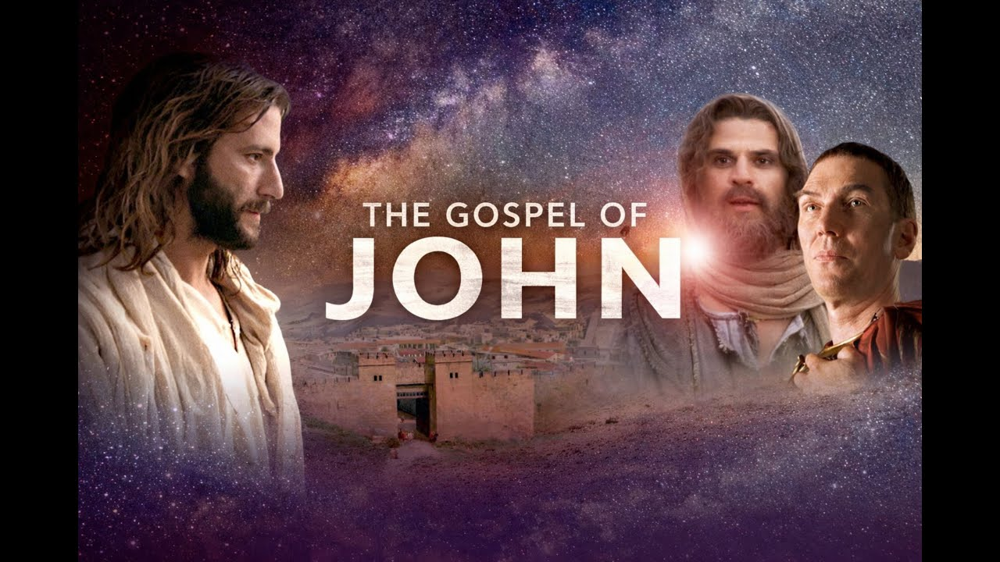
VIDEO
The Gospel of John — Visual Bible
Visual Bible
Cana — water into wine. Queued to 12:51 (John 2:1–11).
youtu.be/-k0D_qFPb4o?t=771
Play on YouTube
Click the preview or the link · starts at 12:51 · youtu.be/-k0D_qFPb4o?t=771

Slide 15
FOR THE TABLE
Do not stop at the sign
1. John moves from words about Jesus to works of Jesus. What does Cana add that chapter 1’s titles did not yet show?
2. “Woman, what does this have to do with me? My hour has not yet come.” How do you still try to schedule the Son?
3. Mary’s last words: “Do whatever he tells you.” Where is obedience waiting on a jar you have not filled?
4. The servants knew. The master did not. Who are you in the story — spectator of good wine, or witness of the Creator?
5. He manifested his glory, and his disciples believed. What would it mean for this sign to move you from titles to trust?
Knowing the sign is not yet believing. Believing is not yet obeying.

Slide 16
CLOSE
What follows
John 2:12–22
Memory
Capernaum, then Jerusalem. Zeal for His Father’s house. The temple cleansing. “Destroy this temple, and in three days I will raise it up.” The hour still ahead.
“This, the first of his signs, Jesus did at Cana in Galilee, and manifested his glory. And his disciples believed in him.”
— John 2:11 ESV
Next in the series: John 2 · zeal for My Father’s house · GTY 43-9

Slide 17

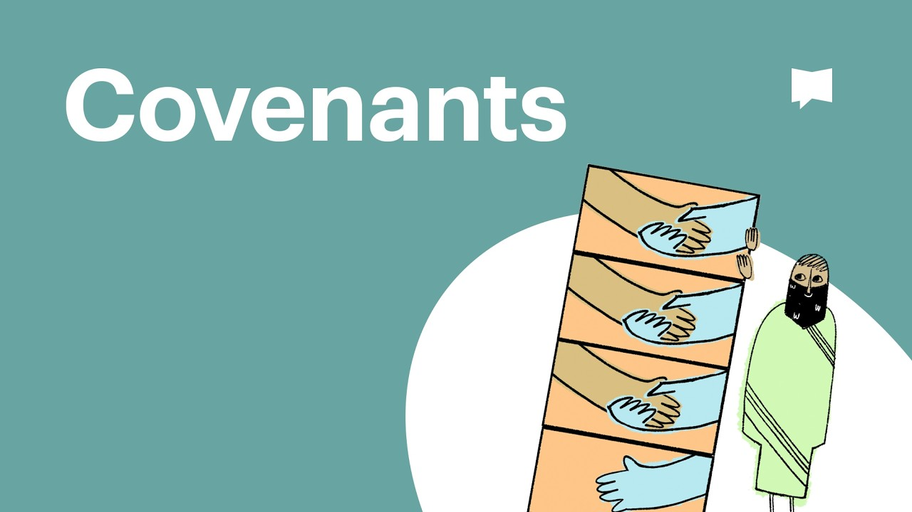
VIDEO
Who is God?
Bible Project
One God — Father, Son, and Spirit — in the story of Scripture.
youtu.be/eAvYmE2YYIU
Play on YouTube
Click the preview or the link · youtu.be/eAvYmE2YYIU

