Slide 1
GOSPEL OF JOHN
John 2:12–17
Zeal for My Father’s House
Capernaum · Passover · The house · The zeal
Core content based on John MacArthur’s Exposition of John · GTY 43-9

Slide 2
FROM LAST WEEK
Cana is behind us — glory made public
John 2:1–11
Now the scene changes
First of His signs. Water into wine.
He manifested His glory.
His disciples believed in Him.
From a village wedding to the temple.
From private provision to public judgment.
Same Son. Same glory. Different register.
Purpose unchanged
These are written that you may believe that Jesus is the Christ, the Son of God, and that by believing you may have life in his name. (John 20:31)
John 20:31 · biblegateway.com

Slide 3
WHERE WE ARE
Public ministry — first Passover
Last week
This week
Next
John 2:1–11
John 2:12–17
John 2:18–25
Cana. The first sign. Glory seen. Disciples believe.
Capernaum, then Jerusalem. He cleanses His Father’s house.
“Destroy this temple.” Deity on display. GTY 43-10.
Two sermons remain in chapter 2. Chapter 3 begins at 43-11.

Slide 4
THE TEXT
John 2:12–17
After this he went down to Capernaum, with his mother and his brothers and his disciples, and they stayed there for a few days.
The Passover of the Jews was at hand, and Jesus went up to Jerusalem. In the temple he found those who were selling oxen and sheep and pigeons, and the money-changers sitting there.
And making a whip of cords, he drove them all out of the temple, with the sheep and oxen. And he poured out the coins of the money-changers and overturned their tables. And he told those who sold the pigeons, “Take these things away; do not make my Father’s house a house of trade.”
His disciples remembered that it was written, “Zeal for your house will consume me.”
John 2:12–17 ESV · biblegateway.com

Slide 5
THE JOURNEY
Down to Capernaum — then up to Jerusalem
After this
Mother, brothers, disciples
The wedding is over. He does not linger as a wonder-worker in Galilee.
Family still travels with Him. His brothers do not yet believe (John 7:5).
A few days
Went up to Jerusalem
Enough time to settle, then the feast pulls Him south.
You always go up to the city, even if the map says south. Passover is near.
John 2:12–13 ESV · biblegateway.com

Slide 6
PASSOVER
The feast that frames His ministry
Mandated in Exodus 12 and 23. Deliverance by the blood of a lamb.
Josephus: the city swells toward a million. Hundreds of thousands of lambs.
His public ministry begins at a Passover and ends at a Passover.
He keeps the Law. He goes up. He will be the Lamb this feast is about.
The first thing He does in the city is not preach a sermon. He purges the house.
Exodus 12 · biblegateway.com

Slide 7
WHAT HE FOUND
The Court of the Gentiles — a market
Oxen, sheep, pigeons
Money-changers
Animals for sacrifice, sold on the premises. Convenience that became a racket.
Temple tax in Tyrian silver. Exchange rates padded 10–12 percent and more.
Annas and the house
A den, not a court
High-priestly family control. Worship turned into a franchise.
The one court open to the nations is filled with noise, dung, and profit.
John 2:14 ESV · biblegateway.com

Slide 8
HOLY ANGER
This is not a tantrum. It is the Son.
What inflames Him
What it is not
Irreverence in the Father’s house.
Extortion dressed as piety.
The nations shut out of prayer.
Isaiah 1 — multiplied sacrifice with unclean hands.
Not loss of control.
Not cruelty to animals or people.
Not a political riot against Rome.
A preview of judgment on false worship.
Isaiah 1:11–17 · biblegateway.com

Slide 9
THE ACT
A whip of cords — and they all leave
Cords are on site — animals are tied with them. He makes a scourge.
He drives them all out: sellers, sheep, oxen. Coins pour. Tables turn.
To the dove-sellers: “Take these things away.” He does not free the birds into chaos.
Temple police do not stop Him. Crowds obey. There is no human explanation for that.
Some say that this is a miracle of authority — a preview of inescapable judgment.
John 2:15–16 ESV · biblegateway.com

Slide 10
MY FATHER’S HOUSE
The claim inside the command
“Do not make my Father’s house a house of trade.”
Not “our” house. Not “this holy place.” My Father’s.
The loyal Son will not watch the Father dishonored on the premises.
Deity is in the pronoun before the next paragraph ever says “destroy this temple.”
He will do this again at the end of the ministry (Matt 21; Mark 11; Luke 19).
John 2:16 ESV · biblegateway.com

Slide 11
THE TEXT
Psalm 69:9 — what the disciples remember
For zeal for your house has consumed me,and the reproaches of those who reproach you have fallen on me.
David’s psalm. The righteous sufferer feels the Father’s dishonor as his own wound. The disciples know the text. They watch the Son live it.
Psalm 69:9 ESV · biblegateway.com

Slide 12
WHAT THIS PREVIEWS
Judgment begins at the house
Then
Now
A.D. 70 — not one stone on another.
He will sit and say it again in Passion Week.
The system that sold access will fall.
You are God’s house (Eph 2:19–22).
Judgment begins with the household of God (1 Pet 4:17).
Zeal for the Father still consumes the Son.
1 Peter 4:17 · Ephesians 2:19–22 · biblegateway.com

Slide 13
FOR THE TABLE
Do not make His house a house of trade
1. Cana showed His glory in provision. The temple shows His glory in holiness. Which one do you prefer to meet?
2. “My Father’s house.” What does the pronoun force you to say about who He is?
3. The Court of the Gentiles was the place for the nations. Where have we crowded out prayer with our own business?
4. Zeal consumed Him. What is different between our anger and the righteous anger of God?
5. If judgment begins at the house of God, what needs turning over in us before we talk about the world?
Knowing the sign is not yet fearing the Son.

Slide 14
CLOSE
What follows
John 2:18–25
Memory
“What sign do you show us?”
“Destroy this temple, and in three days I will raise it up.”
He was speaking of His body.
“Do not make my Father’s house a house of trade.” His disciples remembered that it was written, “Zeal for your house will consume me.”
Next in the series: John 2 · Deity on Display · GTY 43-10

Slide 15
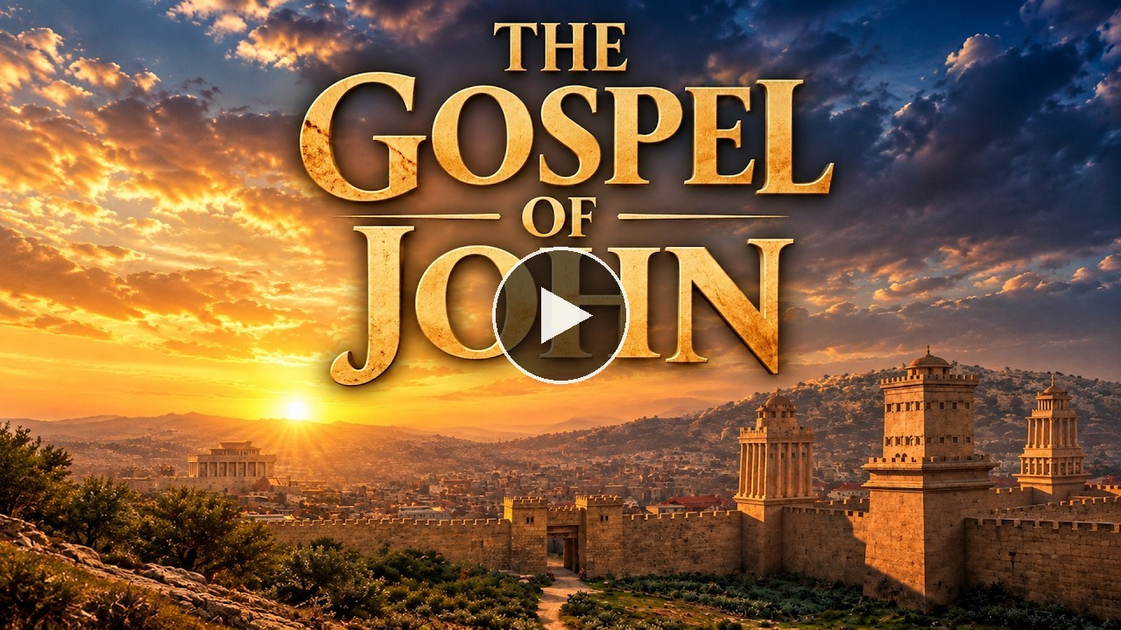
VIDEO
The Gospel of John — Visual Bible
Visual Bible
Cana is over. Passover, then the temple. Queued to 16:07.
youtu.be/-k0D_qFPb4o?t=967
Play on YouTube
Click the preview · starts at 16:07 · opens on YouTube

Slide 16
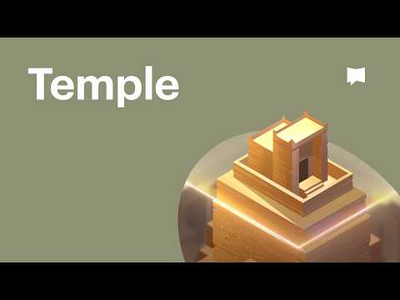
VIDEO
The Temple — Bible Project
Bible Project
God’s space and humanity’s space made one. Jesus is the dwelling.
Embedded player
Plays in Slide Show
Click the player in the slide show. Internet required.

