Slide 1
GOSPEL OF JOHN
John 3:1–10
Jesus Teaches the Teacher
The night · The new birth · The wind
Core content based on John MacArthur’s Exposition of John · GTY 43-11 through 43-14

Slide 2
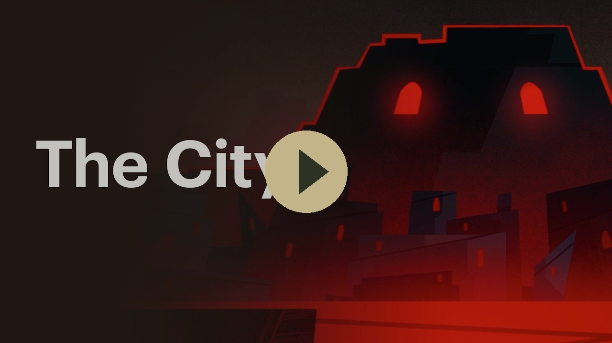
VIDEO
The City — Bible Project
Bible Project
The city that frames this night. Jerusalem, the temple, and the one who comes to it.
Play on YouTube
youtu.be/5yZLFmVHfaw
Click the preview · opens on YouTube

Slide 3
WHERE WE ARE
The night conversation
Last week
This week
Next
John 2:18–25
John 3:1–10
John 3:11–21
The sign of the body.
He knows what is in man.
Born from above.
Water, Spirit, and wind.
Son of Man lifted up. Believe and live.
“For God so loved the world…”
This week: 43-11, 43-12, 43-13, and 43-14.

Slide 4
FROM LAST WEEK
He already knows the man
John 2:23–25
The next man
Many believed when they saw the signs.
He did not entrust Himself to them.
He knew what was in man.
A Pharisee. A ruler of the Jews.
He comes by night.
The signs have drawn him. They have not saved him.
John 2:23–25 ESV · biblegateway.com

Slide 5
THE TEXT
John 3:1–3
Now there was a man of the Pharisees named Nicodemus, a ruler of the Jews. This man came to Jesus by night and said to him, “Rabbi, we know that you are a teacher come from God, for no one can do these signs that you do unless God is with him.”
Jesus answered him, “Truly, truly, I say to you, unless one is born again he cannot see the kingdom of God.”
John 3:1–3 ESV · biblegateway.com

Slide 6
BACKGROUND
The Pharisees, the Sadducees, the Sanhedrin
The Pharisees
The Sadducees
The Sanhedrin
The party of the strict. Law, purity, separation.
About six thousand in the land. Respected, but not a majority.
They are the ones who will oppose Jesus.
The party of the temple. Wealthy, priestly, few.
They hold the Torah only. No resurrection, no angels.
Not in this chapter. They will oppose Him too.
The ruling council in Jerusalem. Chief priests, elders, scribes.
Nicodemus sits on it. So does Joseph of Arimathea.
The body that will later try Jesus.
John 3:1 ESV · biblegateway.com

Slide 7
THE MAN
Nicodemus
A Pharisee. A ruler of the Jews. A man of the Sanhedrin.
John calls him the teacher of Israel. Likely wealthy and older than Jesus.
He comes by night. Fear, curiosity, politics… John does not say.
He opens with a compliment. Jesus does not take it.
John 3:1–2
A man at the top of the religion, but still outside the kingdom.
John 7:50–51
He speaks once in the council, requesting Jesus be treated fairly.
John 19:39
He comes again, by day, with the spices for Jesus’s burial.
John 3:1 · 7:50–51 · 19:39 ESV · biblegateway.com

Slide 8
ANŌTHEN
Again, and from above
The Greek word can mean either or both. Born again. Born from above.
Nicodemus hears only the second birth. “How can a man be born when he is old?”
Jesus means both. A new beginning, and a beginning whose source is God.
Not self-improvement. A gift from above.
John 3:3, 31 ESV · biblegateway.com

Slide 9
THE TEXT
John 3:4–8
Nicodemus said to him, “How can a man be born when he is old? Can he enter a second time into his mother’s womb and be born?”
Jesus answered, “Truly, truly, I say to you, unless one is born of water and the Spirit, he cannot enter the kingdom of God. That which is born of the flesh is flesh, and that which is born of the Spirit is spirit.
Do not marvel that I said to you ‘You must be born again.’ The wind blows where it wishes, and you hear its sound, but you do not know where it comes from or where it goes. So it is with everyone who is born of the Spirit.”
John 3:4–8 ESV · biblegateway.com

Slide 10
WATER AND SPIRIT
Flesh is flesh. Spirit is spirit.
Born of the flesh
Born of the Spirit
A second trip to the womb will not do it.
Religion, office, and night visits will not do it.
Flesh produces flesh.
Water and the Spirit.
A birth from God, not from effort.
He cannot enter the kingdom without it.
John 3:5–6 ESV · biblegateway.com

Slide 11
VERSES CITED
Water and the Spirit in the Old Testament
Isaiah 44:3
“For I will pour water on the thirsty land, and streams on the dry ground; I will pour my Spirit upon your offspring, and my blessing on your descendants.”
Ezekiel 36:25–27
“I will sprinkle clean water on you, and you shall be clean from all your uncleannesses… And I will give you a new heart, and a new spirit I will put within you… And I will put my Spirit within you, and cause you to walk in my statutes.”
Ezekiel 37:9–10
“Prophesy to the breath… Come from the four winds, O breath, and breathe on these slain, that they may live.” So I prophesied as he commanded me, and the breath came into them, and they lived.
Gold references · click a card for BibleGateway ESV

Slide 12
THE WIND
You hear it. You do not steer it.
We do not control the wind.
While we can hear the sound of the wind, its movement seems random to us.
Jesus teaches that God’s spirit moves in a similar fashion.
The "new birth" is not a technique, formula, or a checklist. It is a work of God we cannot earn.
John 3:8 ESV · biblegateway.com

Slide 13
THE TEACHER
Are you the teacher of Israel?
Nicodemus: “How can these things be?”
Jesus: “Are you the teacher of Israel and yet you do not understand these things?”
The man who came to examine the teacher is being taught.
What he should have known from the prophets, he does not know.
John 3:9–10 ESV · biblegateway.com

Slide 14
SO THAT YOU MAY BELIEVE
Four questions this passage answers
Who is He?
The one who will not take the title. He knows the teacher of Israel.
What did He come to do?
To say the true thing: you must be born again, of water and the Spirit.
What does He offer?
The kingdom of God, seen and entered only by a birth from above.
How do you receive it?
Not by being a Pharisee or a ruler. By a work of the Spirit you do not command.
John 20:31 · biblegateway.com

Slide 15
CLOSE
What follows
John 3:11–21
Memory
“We speak of what we know.”
The Son of Man lifted up.
Whoever believes has eternal life.
“Unless one is born of water and the Spirit, he cannot enter the kingdom of God."
Next in the series: John 3:11–21 · GTY 43-15

Slide 16
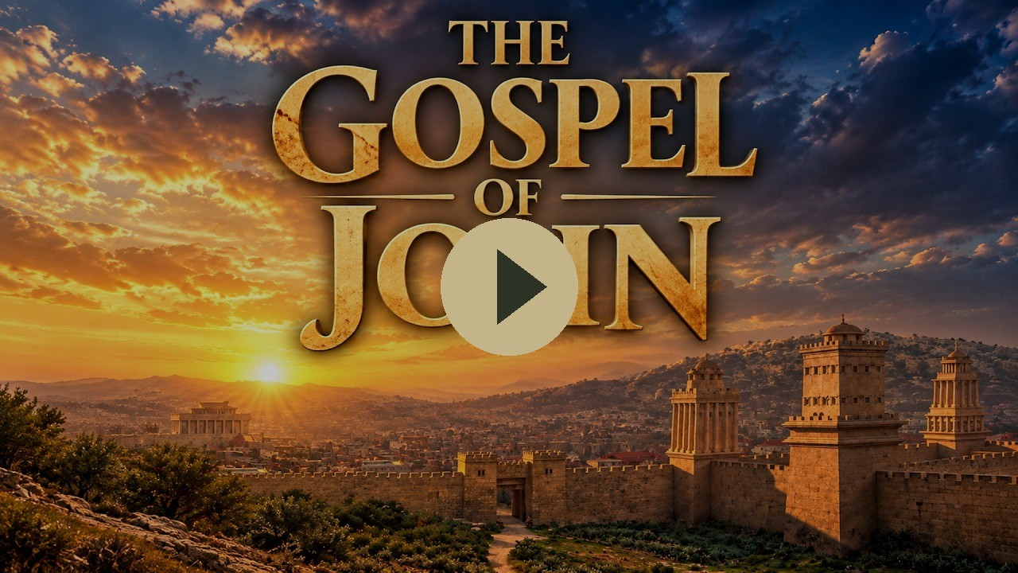
VIDEO
The Gospel of John — Visual Bible
Visual Bible
Nicodemus by night. Queued to the opening of chapter 3.
Play on YouTube
youtu.be/-k0D_qFPb4o?t=1200
Click the preview · starts at 20:00 · opens on YouTube

