Slide 1
GOSPEL OF JOHN
John 3:11–15
The Son Lifted Up
Believe · The serpent · The look
Core content based on John MacArthur’s Exposition of John · GTY 43-15 and 43-16

Slide 2
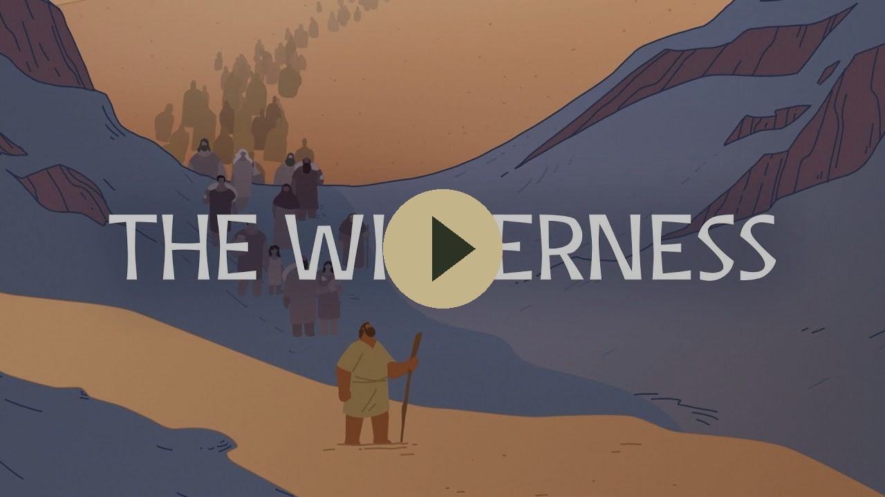
VIDEO
The Wilderness — Bible Project
Bible Project
The wilderness. The place of the serpent, and of the look that brings life.
Play on YouTube
youtu.be/b54d_GhBthI
Click the preview · opens on YouTube

Slide 3
WHERE WE ARE
The night conversation continues
Last week
This week
Next
John 3:1–10
John 3:11–15
John 3:16–21
Born “anothen” (from above).
Water and spirit.
The wind blows where it wishes.
Ascending and descending.
The Son of Man lifted up.
Belief, earthly and heavenly things, eternal life.
For God so loved the world.
Light, darkness, and judgment.
This week: 43-15 and 43-16. 3:16–21 is next week.

Slide 4
REVIEW
The “water and spirit” reference Nicodemus would have known
Ezekiel 36:25–27
“I will sprinkle clean water on you, and you shall be clean… And I will put my Spirit within you, and cause you to walk in my statutes and be careful to obey my rules.”
The teacher of Israel had this. Jesus uses it to clarify what is meant by “born anothen”.
Ezekiel 36:25–27 · John 3:5, 10 ESV · biblegateway.com

Slide 5
REVIEW
Even the teacher of Israel must be born “anothen”
Psalm 143:2
“Enter not into judgment with your servant, for no one living is righteous before you.”
Isaiah 64:6
“We have all become like one who is unclean, and all our righteous deeds are like a polluted garment.”
Habakkuk 2:4
“The righteous shall live by his faith.”
Psalm 143:2 · Isaiah 64:6 · Habakkuk 2:4 · Romans 3:20 ESV · biblegateway.com

Slide 6
REVIEW
God’s sovereignty — a recurring theme in John
John 3:8
“The wind blows where it wishes, and you hear its sound, but you do not know where it comes from or where it goes. So it is with everyone who is born of the Spirit.”
John 1:13
“Who were born, not of blood nor of the will of the flesh nor of the will of man, but of God.”
The new birth is not of human will. God's sovereignty is declared throughout John (though often alongside appeals to human belief).
John 3:8 · John 1:13 ESV · biblegateway.com

Slide 7
THE TEXT
John 3:11–15
“Truly, truly, I say to you, we speak of what we know, and bear witness to what we have seen, but you do not receive our testimony.
If I have told you earthly things and you do not believe, how can you believe if I tell you heavenly things?
No one has ascended into heaven except he who descended from heaven, the Son of Man.
And as Moses lifted up the serpent in the wilderness, so must the Son of Man be lifted up, that whoever believes in him may have eternal life.”
John 3:11–15 ESV · biblegateway.com

Slide 8
THE WE
The heavenly and earthly councils
Genesis 1:26
Then God said, “Let us make man in our image, after our likeness.”
Us. Our. The plural is already there, at the making.
John 3:11
Jesus: “We speak of what we know, and bear witness to what we have seen, but you do not receive our testimony.”
We. Our. The same voice, now to the teacher of Israel.
John 3:2
Nicodemus: “Rabbi, we know that you are a teacher come from God.”
A council speaking from below.
John 3:11
Jesus: “We speak of what we know, and bear witness to what we have seen, but you do not receive our testimony.”
Testimony from above.
Genesis 1:26 · John 3:2, 11 ESV · biblegateway.com

Slide 9
ASCENDING AND DESCENDING
Jacob’s ladder – connecting heaven and earth
Genesis 28:12–13
“And he dreamed, and behold, there was a ladder set up on the earth, and the top of it reached to heaven. And behold, the angels of God were ascending and descending on it. And behold, the Lord stood above it.”
John 3:13
“No one has ascended into heaven except he who descended from heaven, the Son of Man.”
The ladder is a person.
Genesis 28:12–13 · John 1:51 · John 3:13 ESV · biblegateway.com

Slide 10
SON OF MAN
Son of Man lifted up
Daniel 7:13–14
“I saw in the night visions, and behold, with the clouds of heaven there came one like a son of man, and he came to the Ancient of Days and was presented before him. And to him was given dominion and glory and a kingdom, that all peoples, nations, and languages should serve him; his dominion is an everlasting dominion.”
Jesus is the Son of Man who descended and who will be exalted on the cross.
Daniel 7:13–14 · John 3:13–14 ESV · biblegateway.com

Slide 11
VERSES CITED
The serpent lifted up
Numbers 21:8–9
“Make a fiery serpent and set it on a pole, and everyone who is bitten, when he sees it, shall live.” So Moses made a bronze serpent and set it on a pole. And if a serpent bit anyone, he would look at the bronze serpent and live.
John 3:14–15
“And as Moses lifted up the serpent in the wilderness, so must the Son of Man be lifted up, that whoever believes in him may have eternal life.”
Gold references · click a card for BibleGateway ESV

Slide 12
SO THAT YOU MAY BELIEVE
Four questions this passage answers
Who is He?
The Son of Man who descended, and who must be lifted up.
What did He come to do?
To be lifted up, as the serpent was, that whoever believes may have eternal life.
What does He offer?
Eternal life. Whoever believes in him has it.
How do you receive it?
By believing. A look, as Israel looked at the serpent.
John 20:31 · biblegateway.com

Slide 13
CLOSE
What follows
John 3:16–21
Memory
For God so loved the world.
Sent not to condemn, but to save.
The light has come… but people loved the darkness.
As Moses lifted up the serpent in the wilderness, so must the Son of Man be lifted up.
Next in the series: John 3:16–21 · GTY 43-17

Slide 14
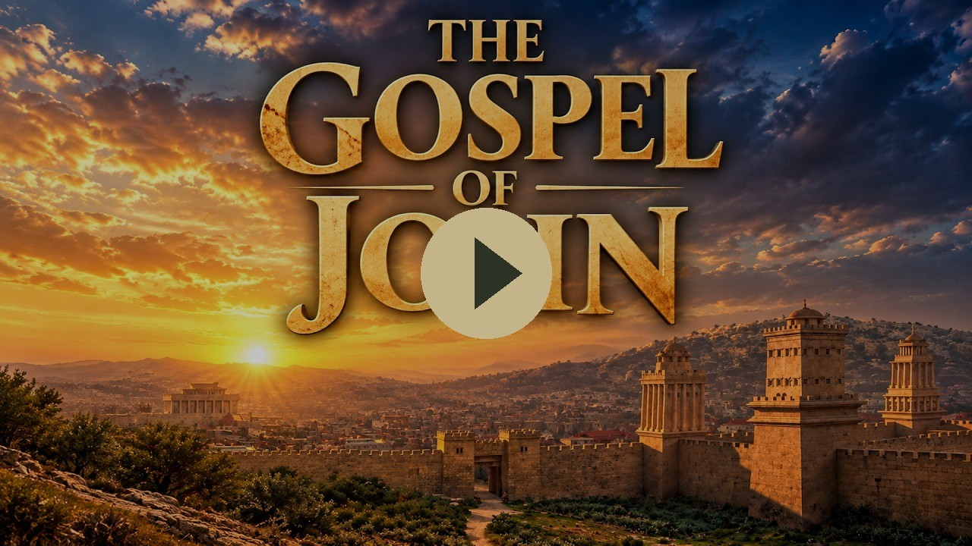
VIDEO
The Gospel of John — Visual Bible
Visual Bible
The Son of Man lifted up. Queued to John 3:11.
Play on YouTube
youtu.be/-k0D_qFPb4o?t=1291
Click the preview · starts at 21:31 · opens on YouTube

